Slide 1
ONLINE CLOTHING
Presented by : P. Lavanya
Enrolled No: EBEon0922659370
Batch No : 7942-2022

Slide 2
OVERVIEW
Introduction
Requirement
Feasibility
Design
Screen shots of site
Live demo
Future scope
conclusion

Slide 3
INTRODUCTION
Shopping is one of the essential part of our daily life.
Were using different types of shops to buy different kind of things everyday.
Physical life : we met everyone physically.
Virtual life : we meet people on a virtual world called Internet.

Slide 4
REQUIREMENT
Software :
Window OS: xp /7/8/8.1 or mac OS or Linux
Hardware :
Processor :Pentium or Higher
RAM :128MB or Higher

Slide 5
FEASIBILITY
Technical feasible: Technically , this project is very feasible because of use of current and latest techniques.
Operational feasible: very easy to use.

Slide 6
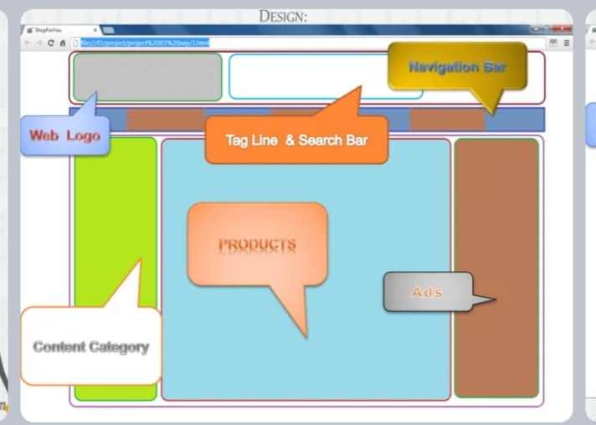

Slide 7
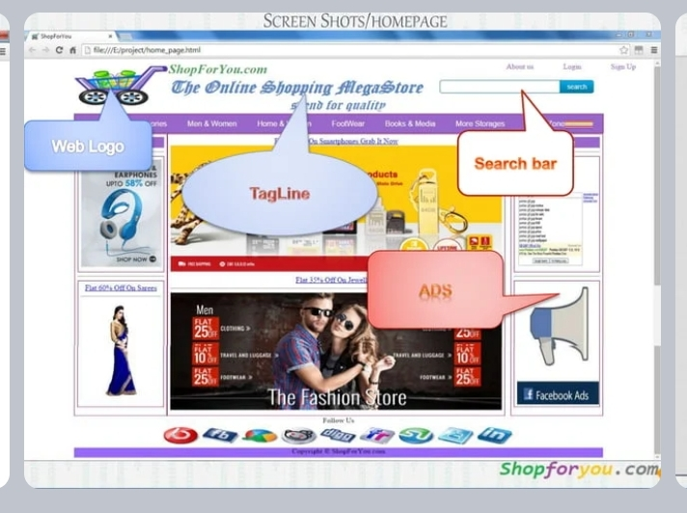

Slide 8
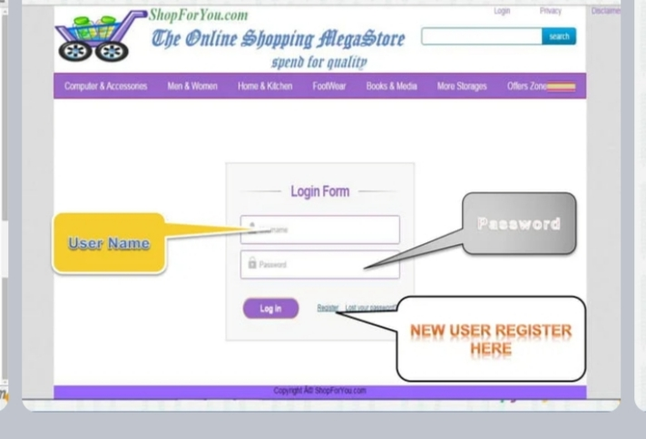

Slide 9
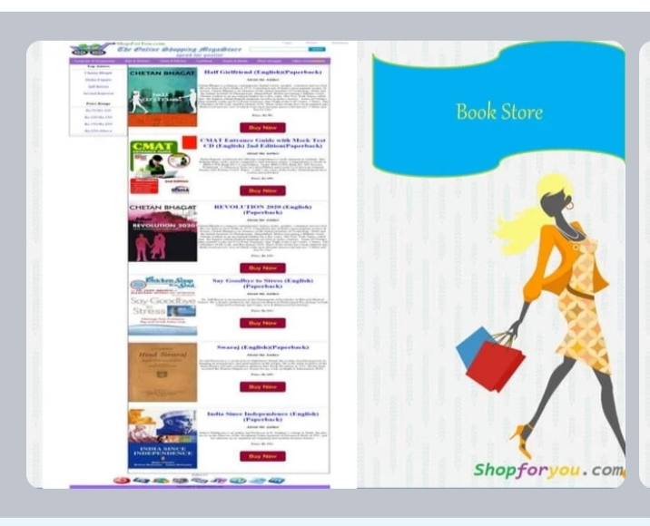

Slide 10
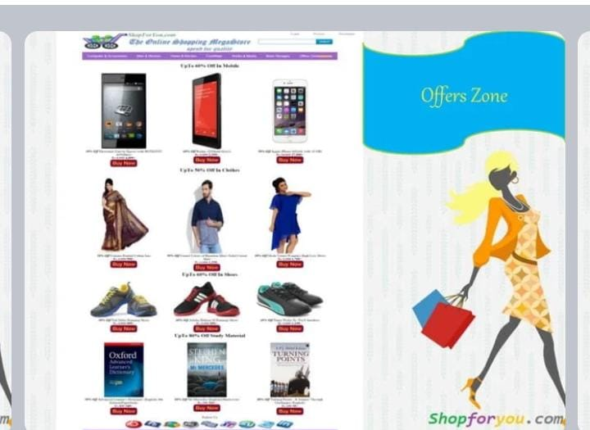

Slide 12
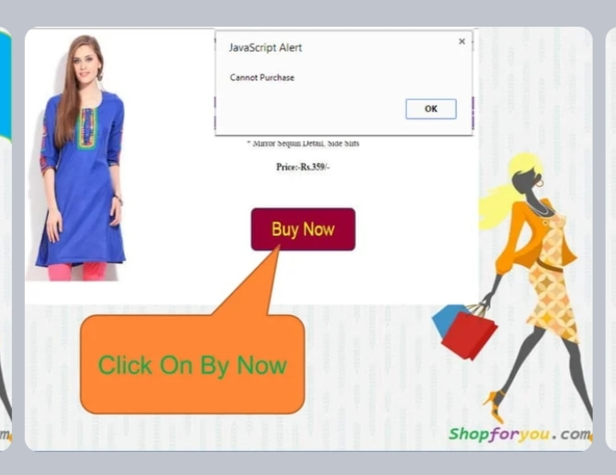

Slide 13
FUTURESCOPE
The project made here is just to ensure that this product could be valid in today real challenging world.
Currently It is not visible on virtual world because of some limitations of project.

Slide 14
CONCLUSION
Online shopping is the best way to purchase any item be careful because there may be some fake products on different sites.
Only purchase those items which can be recognised easily that item is fake or not or choose according rating of buyers
But not to worry , on my site you will get all items genuine and trusty just check once here before buy anywhere.
Shop for you.com
The online shopping mega store spend for quality

Slide 15


